Slide 1
Convertible bond calculator --for china market
Objected oriented programming
Ke gao

Slide 2
Content
What is convertible bond?
Plain vanilla convertible bond
Convertible bond = bond + call option
Programming design
Components of program
GUI design
Compare two convertible bonds (China Citic Bank and China Ping An Bank)
Summary

Slide 3
What is convertible bond?
A convertible bond is a fixed-income debt security that pays interest payments but can be converted into a predetermined number of common stock or equity shares.
The conversion from the bond to stock can be done at certain times during the bond's life and is usually at the discretion of the bondholder.
There are lots of types of convertible bonds, we only discuss plain vanilla convertible bond.

Slide 4
Plain vanilla convertible bond
A plain vanilla convertible bond provides the investor with the choice to hold the bond until maturity or convert it to stock.
If the stock price has decreased since the bond's issue date, the investor can hold the bond until maturity and get paid the face value.
If the stock price increases significantly, the investor can convert the bond to stock and either hold or sell the stock at their discretion.

Slide 5
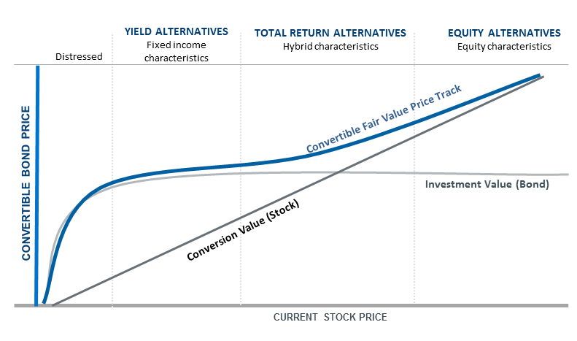
Convertible bond = bond + call option

Slide 6
Convertible bond = bond + call option
Let's say Exxon Mobil Corp. (XOM) issued a convertible bond with a $1,000 face value that pays 4% interest. The bond has a maturity of 10 years and a convertible ratio of 100 shares for every convertible bond. Right now the stock price of XOM is $10.
If the bond is held until maturity, the investor will be paid $1,000 in principal plus $40 in interest for each year.
However, the company's shares suddenly spike and are trading at $11 per share. As a result, the 100 shares of stock are worth $1,100 (100 shares x $11 share price), which exceeds the value of the bond. The investor can convert the bond into stock and receive 100 shares, which could be sold in the market for $1,100 in total.

Slide 7
Programming design
We use PyQt5 for creating GUI
We use these packages:
Package Name | Function
Matplotlib.pyplot | Convertible bond plot
Tushare | Get stock and convertible bond quotes
PyQt5 | GUI
datetime | Calculate bond maturity
numpy | Array and matrix
pandas | Dataframe
SciPy | Scientific computing

Slide 8
Components of program
Class Name | Function
Option | Option value calculation by Black Scholes Model
Bond | Bond value calculation by present value approach
ConvertibleBond | Combine class Option and class Bond
CBPlot | Generate figure of convertible bond
GUI | Generate GUI

Slide 9
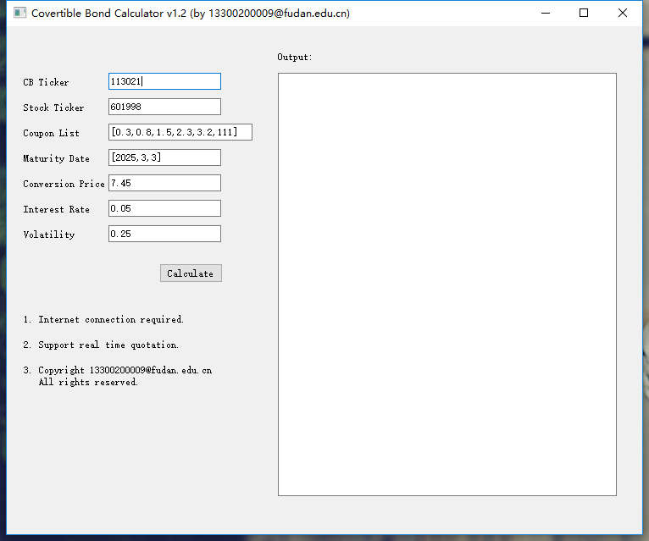
GUI dESIGN
Example: China CITIC bank convertible bond (中信银行可转债)
Input | Type | Example:
CB Ticker | str | 113021
Stock Ticker | str | 601998
Coupon list | list | [0.3,0.8,1.5,2.3,3.2,111]
Maturity Date | list | [2025,3,3]
Conversion Price | float | 7.45
Interest rate | float | 0.05
Volatility | float | 0.25

Slide 10
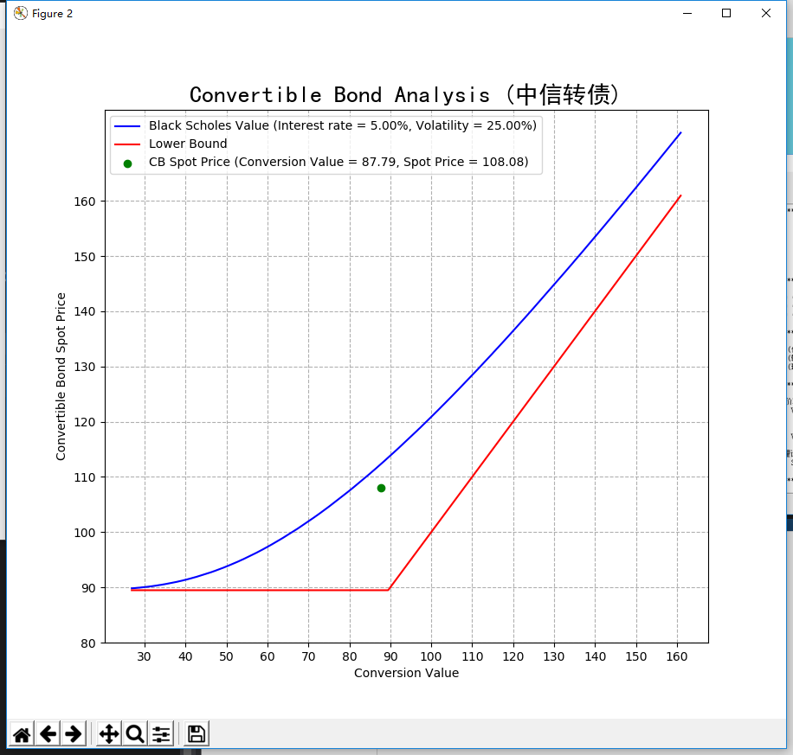
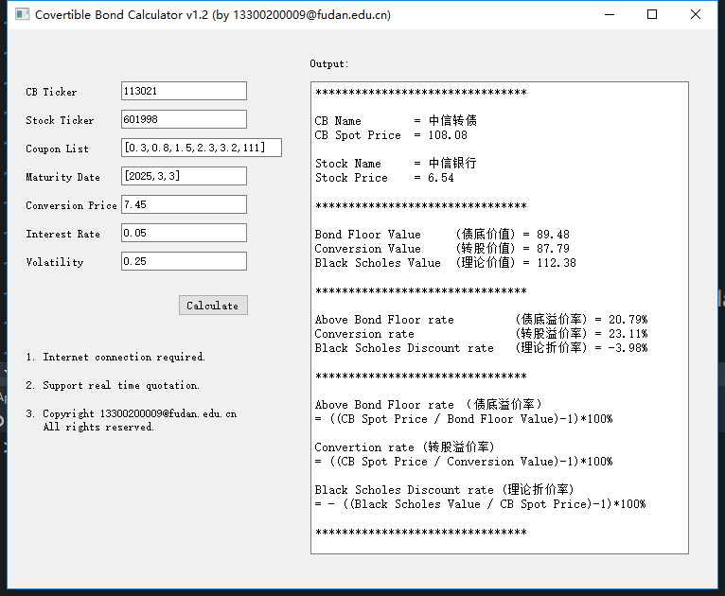
Example: China CITIC bank convertible bond (中信银行可转债)

Slide 11
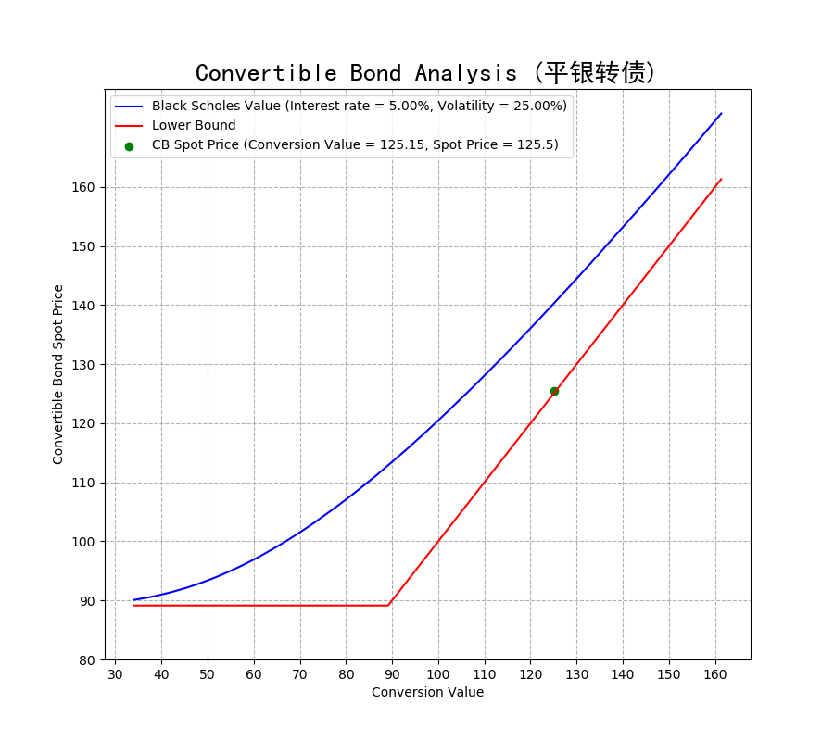
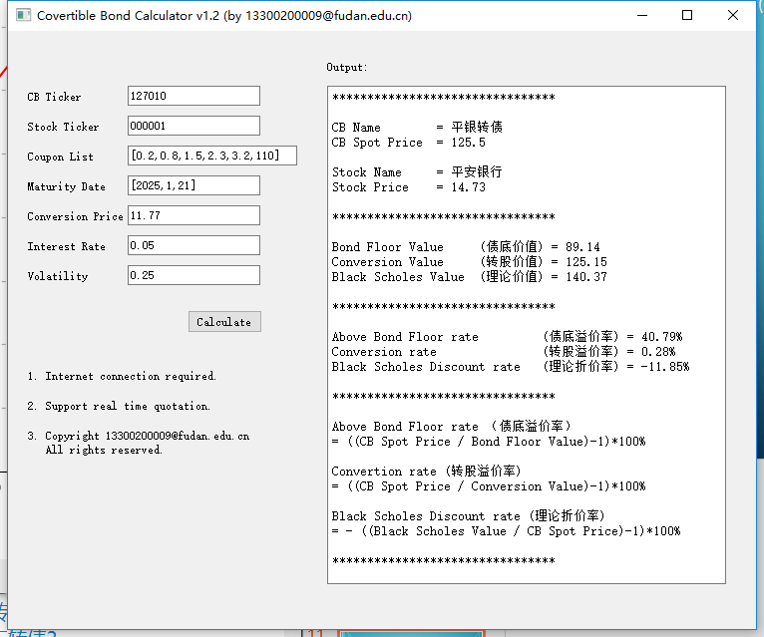
Example: China Ping An bank convertible bond (平安银行可转债)

Slide 12
Compare two convertible bonds
Convertible bond name | China Citic Bank | China Ping An Bank
Coupon list | [0.3,0.8,1.5,2.3,3.2,111] | [0.2,0.8,1.5,2.3,3.2,110]
Maturity Date | [2025,3,3] | [2025,1,21]
Convertible bond ticker | 113021 | 127001
Stock ticker | 601998 | 000001
Conversion price | 7.45 | 11.77
Interest rate | 0.05 | 0.05
Volatility | 0.25 | 0.25

Slide 13
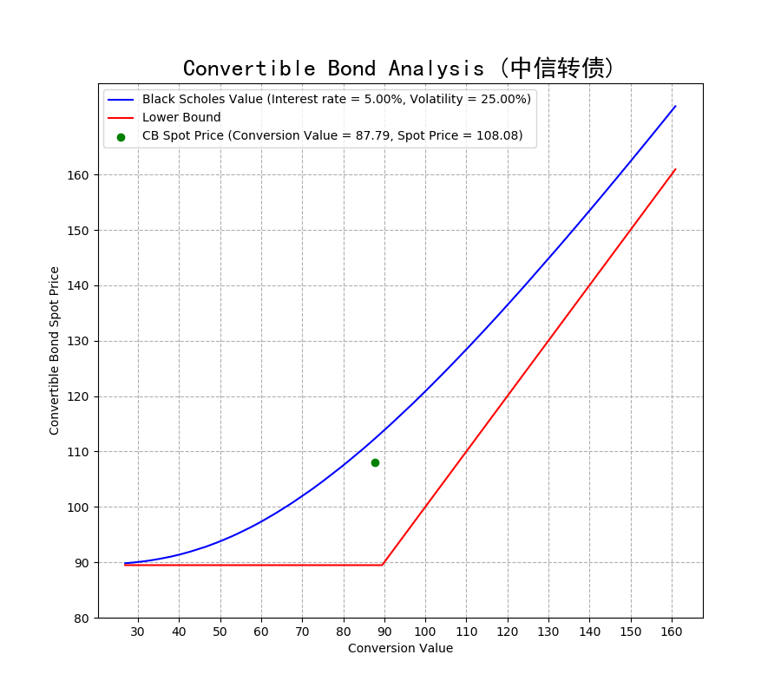
Compare two convertible bonds
China Citic Bank Convertible Bond
China Ping An Bank Convertible Bond

Slide 14
Compare two convertible bonds
********************************
CB Name = China Citic Bank Convertible Bond
CB Spot Price = 108.08
Stock Name = China Citic Bank
Stock Price = 6.54
********************************
Bond Floor Value (债底价值) = 89.48
Conversion Value (转股价值) = 87.79
Black Scholes Value (理论价值) = 112.38
********************************
Above Bond Floor rate (债底溢价率) = 20.79%
Conversion rate (转股溢价率) = 23.11%
Black Scholes Discount rate (理论折价率) = -3.98%
********************************
********************************
CB Name = China Ping An Bank Convertible Bond
CB Spot Price = 125.5
Stock Name = China Ping An Bank
Stock Price = 14.73
********************************
Bond Floor Value (债底价值) = 89.14
Conversion Value (转股价值) = 125.15
Black Scholes Value (理论价值) = 140.37
********************************
Above Bond Floor rate (债底溢价率) = 40.79%
Conversion rate (转股溢价率) = 0.28%
Black Scholes Discount rate (理论折价率) = -11.85%
********************************

Slide 15
SUMMARY
We build a convertible bond calculator by PyQt5 and matplotlib
We analysis convertible bond with Black Scholes model for option part and present value approach
We analyze two different convertible bonds and key ratios

Slide 16
Thank you

